Slide 1
Sound

Slide 2
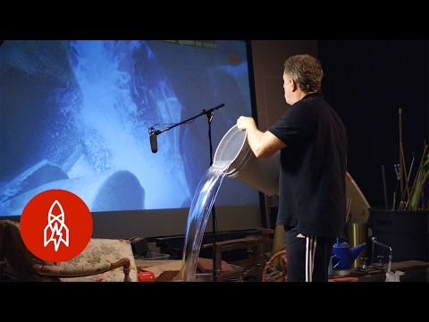
Foley Art

Slide 3
In Class Activity
In groups (I will give you groups) find a video on youtube to recreate the sound for.
You may use anything you can find in the room to make the sounds for the video. Each person in your group must participate in creating the sound.
Hint: Cartoons without dialogue are best to use for this!

